Slide 1

DEPARTMENT OF INFORMATION TECHNOLOGY
A
SEMINAR REPORT
ON
An IoT Based User Centric Ecosystem for Heterogeneous Smart Home Environments.
OF
T.E. ( INFORMATION TECHNOLOGY )
(Academic Year: 2015-2016)
SUBMITTED BY
Tejas Naik
Sarvanan G
Smit Sheth
Abhinav Shirore
GUIDED BY
Prof. T.A. Rane
Society for Computer Technology & Research’s
PUNE INSTITUTE OF COMPUTER TECHNOLOGY
Savitribai Phule University of Pune
(2015-2016)

Slide 2
Agenda:
Introduction to Home Automation
What is a Smart home?
Necessary Concepts for the implementation of a Smart Home
Indoor Localization
Machine to Machine Communication(M2M)
Information Centric Networking
Conclusion And Future Scope

Slide 3
Introduction
Imagine how helpful it will be to be able to switch on your air conditioning system ten minutes before you get home on a hot afternoon in January.
How about having a security system that will detect smoke, excessive electrical power usage, burglar attempts and unauthorized movements in your house and alert you? This is what home automation is about and there is no end to its application.

Slide 4
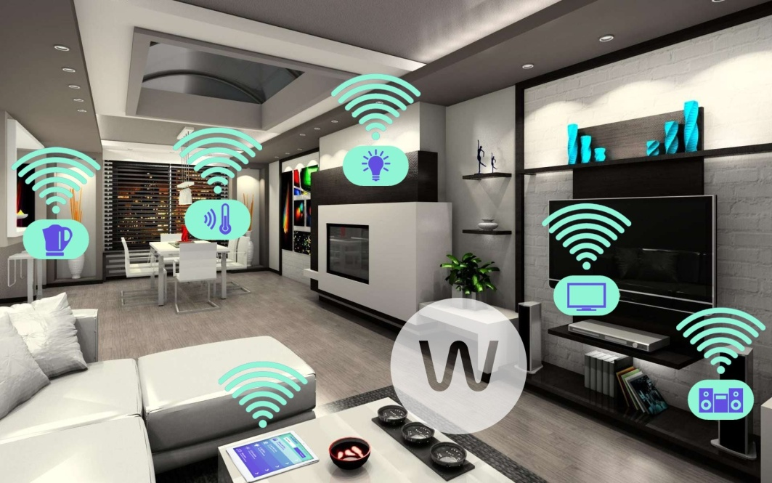
Home automation has made it possible to have what is often referred to as a 'smart home', a home that can detect and identify you, automatically adjust the lighting to your predefined taste.
It makes it possible to link lighting, entertainment, security, telecommunications, heating, and air conditioning into one centrally controlled system.
Automated home (http://technoeyevision.com/)

Slide 5
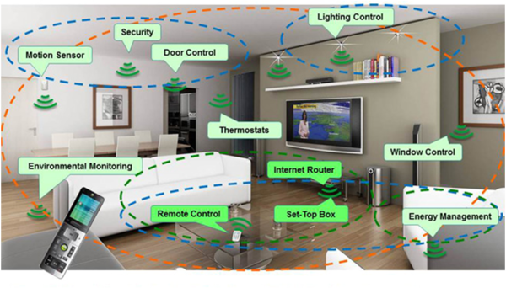
Overview of Smart Homes
Smart home(http://technoeyevision.com)

Slide 6
What is a Smart Home?
The Smart Home is a home automation system that allows for control over a home’s environmental, security, and media systems from a centralized network core with an easily accessible user interface.
The environmental system can control the house’s lighting. The security system will constantly monitor for break-ins through windows and doors and give the user remote control over door locks..

Slide 7
A user-friendly GUI allows for easy control of all these features. The integration of these everyday systems will give the average homeowner the control they desire within their home.
Low-power and low-cost devices are expected to create a network of interconnected smart objects able to transform our homes into real Smart Homes.
The term “smart home” refers to a home embedded with sensors, with which to observe the environment and its occupants’ activities, and actuators, with which to automatically control the home ambience and devices to improve the occupants’ experience

Slide 8
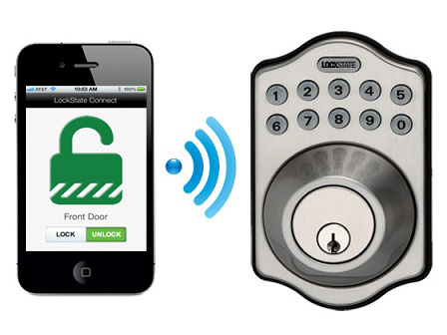
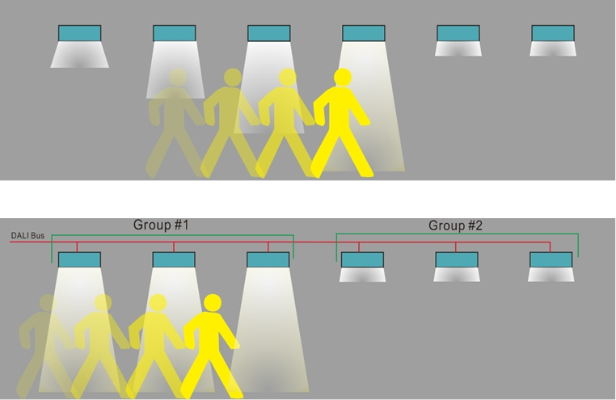
Examples of Smart systems
Smart locks
Smart Lighting
Smart Lock(http://www.ecnmag.com/)
Smart lighting(http://www.ecnmag.com/)

Slide 9
Internet of Things in Smart Homes
The Internet Of Things is leading in the development of a plethora of smart objects that are intended to transform homes into real Smart Homes (SH).
In this perspective, taking advantage of the latest innovations in the Information and Communication Technology(ICT), the home automation devices are gaining increasing attention both in industry and in academia, since they are able to improve the comfort, safety and energy efficiency of our homes.
The proposed system provides a multi-protocol middleware that allows a transparent access to the heterogeneous IoT technologies hiding the low-level communication details.

Slide 10
Multi-Protocol Middleware
The multi-protocol middleware is the software component through which both the location-aware services and the mobile application are able to interact with the home devices.
The main feature of the middleware is the ability to abstract the heterogeneity of the underlying technologies, providing a common interface to the upper layers.
It allows to transparently communicate with heterogeneous technologies. To make possible this kind of approach, the middleware is equipped with appropriate software modules, the adapters, which are able to communicate with the IoT technologies according to the respective standards and protocols.

Slide 11
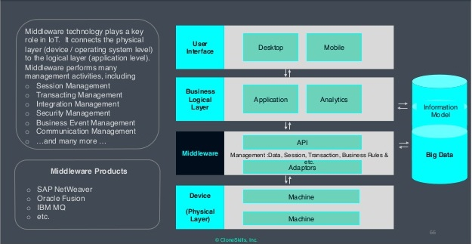
Middleware Protocol in IoT
Middleware Protocol (http://www.ecnmag.com/)

Slide 12
Concepts for Smart Homes
Indoor Localization:
M2M Communication:
.
ICN(Information Centric Networking)

Slide 13
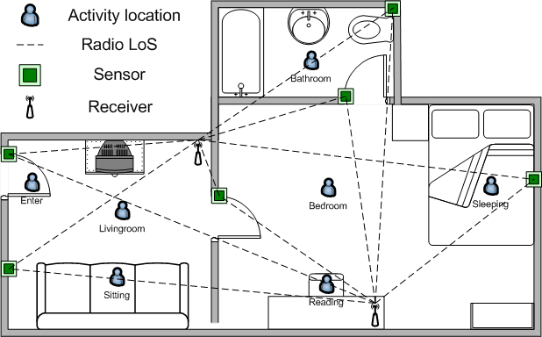
Indoor Localization
Indoor Localization Location of Sensors (http://www.ecnmag.com/)

Slide 14
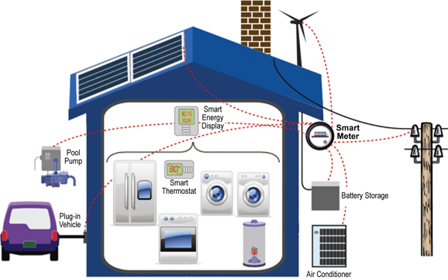
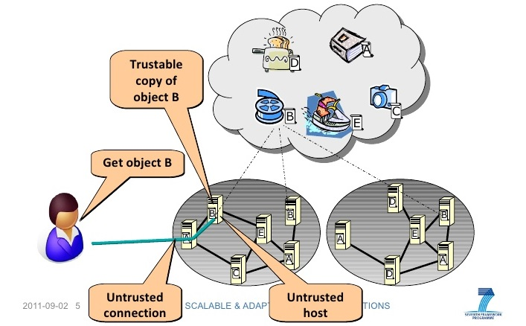
M2M Communication
Information Centric Networking
Machine to machine (http://www.ecnmag.com/)

Slide 15
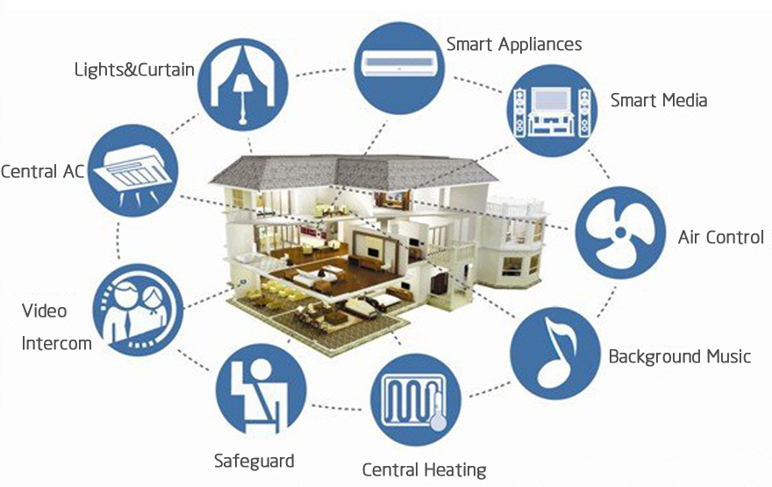
Smart-Condo: Optimizing Sensor Placement for Indoor Localization

Slide 16
SMART-CONDO : INDOOR LOCALIZATION
Hardware/software platform that aims to support and assist an individual in performing a variety of everyday tasks within his/her living space.
The key to achieving this goal is being able to recognize the individual’s general activities in real-time, without impeding these activities or compromising privacy.
The Smart-Condo was conceived as a multipurpose platform for a variety of services such as location- and activity-recognition, alert generation, home automation, etc.

Slide 17
Many of these services rely on accurate occupant localization and movement analysis. Our platform employs passive infrared (PIR) motion sensors due to the privacy-respecting nature of their operation, i.e., the only information captured is whether motion occurred within a sensor footprint.
Such a technology is more likely to be accepted by users sensitive to video-surveillance techniques, but this benefit comes at the cost of lower localization accuracy.

Slide 18
MOBILITY MODELING
Floorplan Color Coding
Calculating Visitation Frequencies

Slide 19
Floor plan Color Coding
Objects of Interest
Five Types of Objects:
1. Walls
2. Doorways / Sliding Doors
3. Impassable Fixed-Position Obstacles, i.e., all large pieces of furniture
4. Obstacles that may Frequently Change Positions, e.g. Chairs
5. Areas of Interest associated with every Object of Interest (narrow strips next to the articles of furniture).

Slide 20
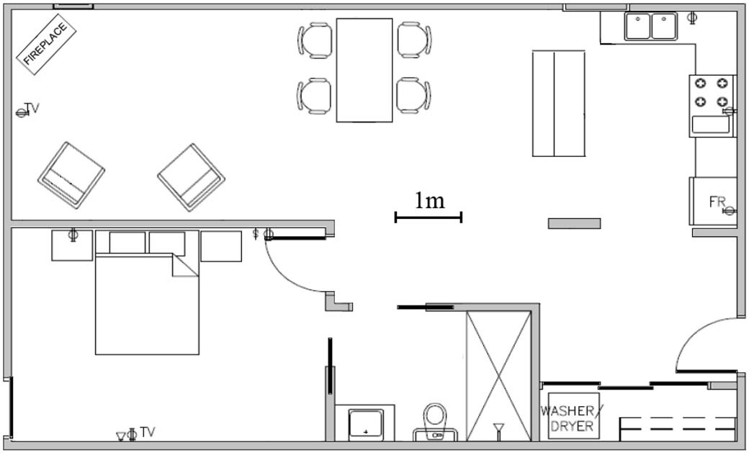
Smart-Condo Floor Plan (Walls, Doors)

Slide 21
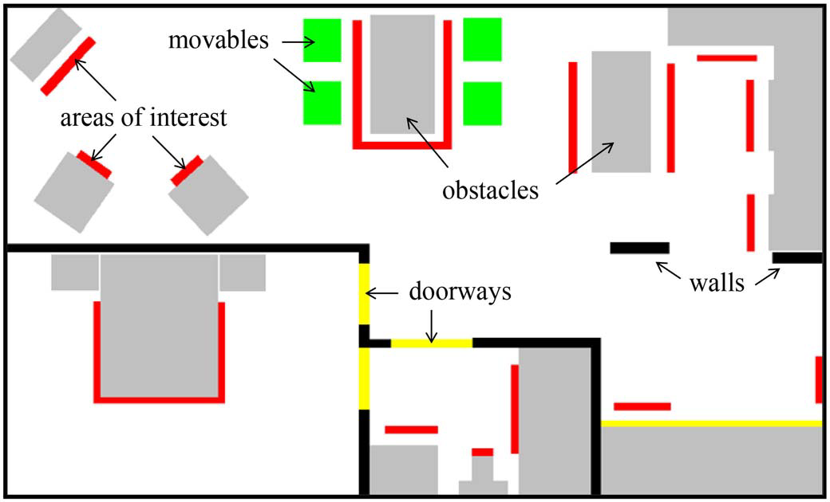
Augmented Floor Plan

Slide 22
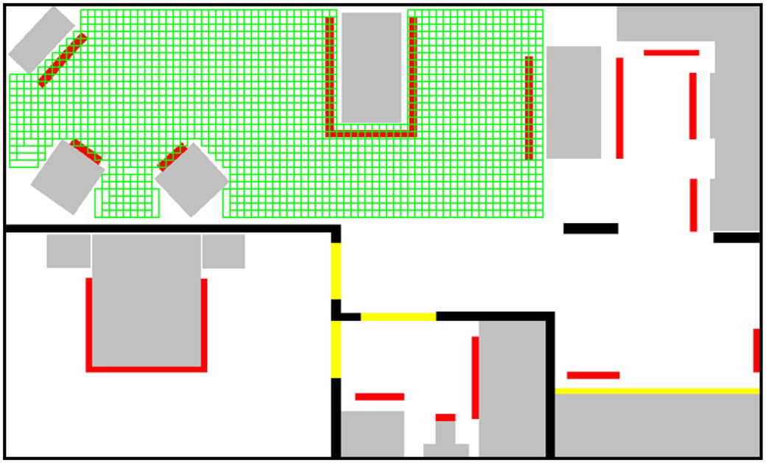
Grid of all Positions that can be potentially occupied by the Movable Obstacles

Slide 23
Calculating Visitation Frequencies
Path Finding Algorithm (PFA)
Start and Goal points representing Objects of Interest
Positions of the Movables
Blockage of a number of Walkable points

Slide 24
Placement Strategies
Optimized Placements
Manual Placements

Slide 25
Advantages
Supports people to live independently at home.
Privacy-respecting and Nonintrusive Monitoring Infrastructure.
Achieves maximum coverage of the Sensing Field from a typical sensor placement objective to maximize an application specific utility-score function.

Slide 26
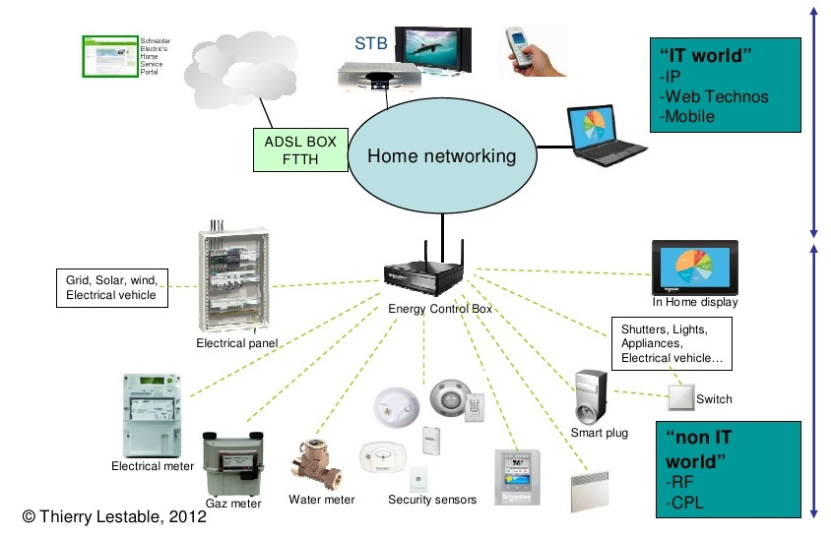
M2M Communication
Fig. M2M communication (http://www.sdmmag.com)

Slide 27
What is M2M ?
Machine to machine refers to direct communication between devices using any communications channel, including wired and wireless.
M2M communications enables networked devices to exchange information among each other as well as with business application servers.

Slide 28
What is Cognitive M2M ?
Cognitive M2M is the use of cognitive radio technology in M2M communications.
Cognitive radio technology provides as a novel approach to address the spectrum scarcity and spectrum inefficiency issue in wireless networks.
However cognitive M2M communications requires a cognitive radio-enabled protocol stack.

Slide 29
Core Requirements For The Protocol Stack
Energy-efficient protocol stack
Internet-enabled protocol stack
Highly reliable protocol stack

Slide 30
Protocol Stack For Cognitive M2M
Fig. Protocol stack for M2M communications [4].

Slide 31
Physical Layer For Cognitive M2M
The IEEE 802.15.4m TG provides the PHY layer specifications for cognitive M2M network.
IEEE 802.15.4m TG (Low Rate WPAN) deals with low data rate but very long battery life (months or even years) and very low complexity

Slide 32
MAC Layer For Cognitive M2M
IEEE 802.15.4m
The network topology in an IEEE 802.15.4m-based cognitive M2M network consists of two types of devices:
Full function device (FFD)
Reduced function device (RFD)
Multiple devices form a personal area network (PAN).
Each PAN has a PAN coordinator, which acts like a centralized controller.
Devices inside a PAN are connected through a master–slave connectivity.
The master device is responsible for enabling the operation of associated slave devices.

Slide 33
The master device obtains the channel availability information and sends an enabling signal.
Devices in a PAN periodically scan for the enabling signal and register with the master device upon reception.
Fig. Network topology in IEEE 802.15.4m [4].

Slide 34
Network Layer For Cognitive M2M
CORPL:
Cognitive and Opportunistic Routing for Low Power and Lossy Networks(CORPL) is a distance-vector protocol.
CORPL uses an opportunistic forwarding approach that consists of two key steps:
selection of a forwarder set
a coordination scheme to ensure that only the best receiver of each packet forwards it (unique forwarder selection).
The Directed Acyclic Graph(DAG) is constructed.
CORPL considers two different routing classes:
The first class (class A)
The second class (class B)

Slide 35
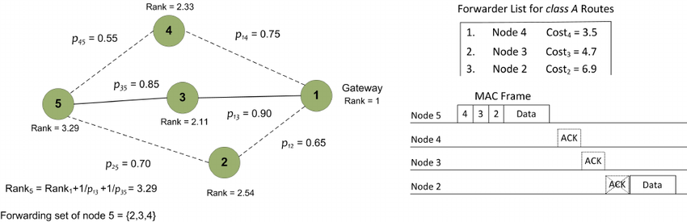
After detecting a vacant channel, the gateway node transmits a destination information object (DIO) message.
The expected transmission count (ETX )of a link will be measured and updated continuously, once the link starts to carry data traffic.
The forwarder set is constructed in such a way that the forwarding nodes are within the transmission range of each other.
Fig. CORPL (http://ieeexplore.ieee.org)

Slide 36
Transport And Above Layer For Cognitive M2M
Transport Layer Protocol:
TP-CRAHN(Transport Protocol for Cognitive Radio Ad-Hoc Network)
This protocol integrates as an end-to-end metric, the spectrum sensing, and switching functionalities in a cognitive radio network
Application Layer Protocol:
CoAP (Constrained Application Protocol)
Its specialized web transfer protocol for use with constrained nodes and constrained networks.

Slide 37
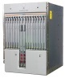
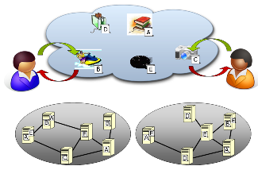
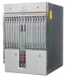
Information Centric Networking
Information Centric Network
Focus on information objects
Today’s Internet
Focus on
nodes
In today’s Internet, accessing information is the dominating use case!
Evolution
Web
CDN
P2P
Considering important requirements
Accessing named resources – not hosts
Scalable distribution through replication and caching
Good control of resolution/routing and access
With ubiquitous caching
But for all applications
And for all users and content/service providers
Notes:
Evolution:
In traditional telephony networks the focus was on connecting wires. The major breakthrough was moving to automatic switching.
In Internet the focus has been on interconnecting nodes via a packet switched network. The original design did not take mobility and security into account.
In the Future Internet, which SAIL addresses, the vision is to focus on networking of information.
Networking of Information:
It is the information that is important to users, not the nodes
And the quality and properties of that information
Where it came from is less important
As long as it has the desired properties, including authenticity
As the architecture focuses on the information objects themselves the underlying network infrastructure needs to transparently support things like mobility, multihoming and security.

Slide 38
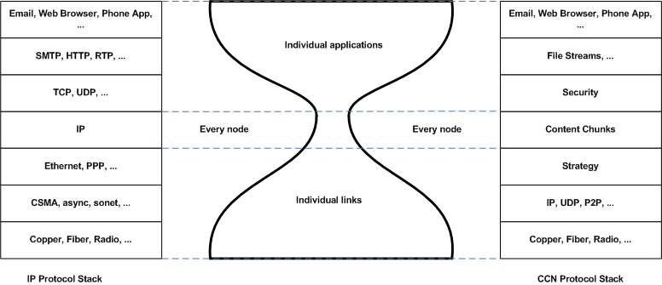
ICN STACK

Slide 39
ICN FRAMEWORK
The NDOMUS((Named Data netwOrking for sMart home aUtomation Systems)) framework shown in the figure is based on the NDN IoT architecture.
All nodes implement the NDN building blocks designed for the conceived Data and Management/Control planes, but with different restrictions that depend on their role and resource availability.

Slide 40
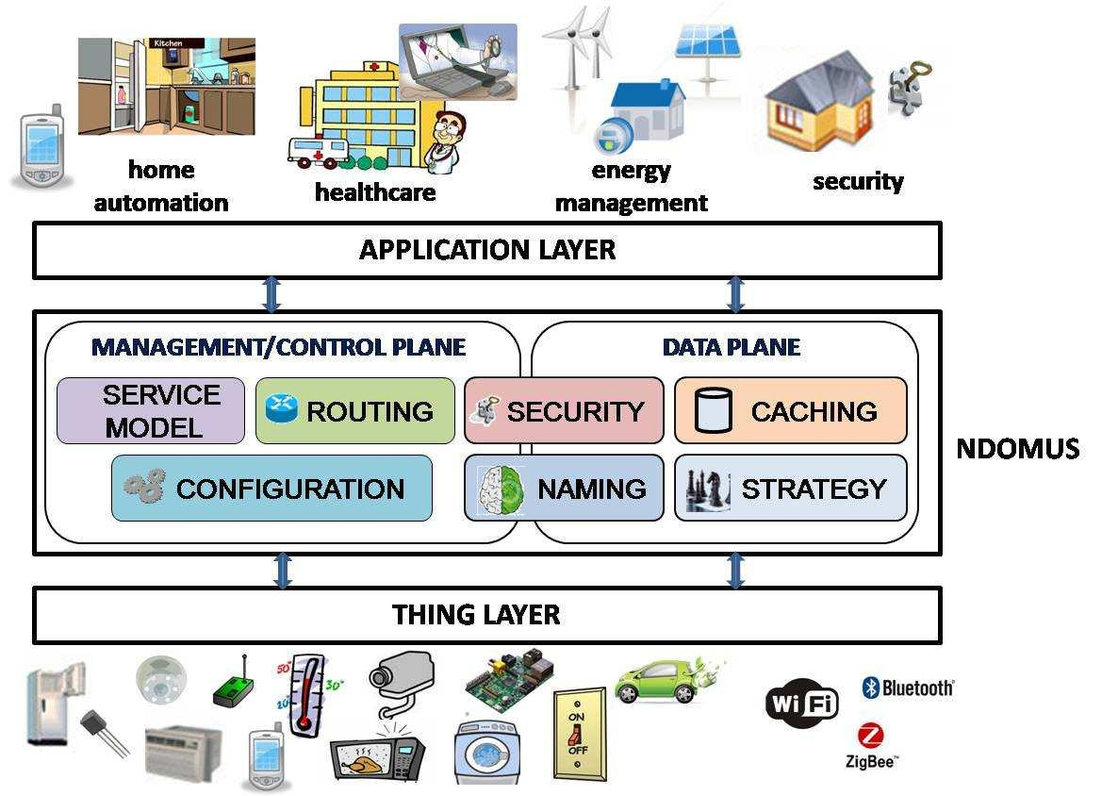
Fig. The NDOMUS framework [3].

Slide 41
COMMUNICATION IN ICN
There are two ICN packet types:
1)interest (similar to http “get”)
2)data(similar to http response).
Both are encoded in an efficient binary XML.

Slide 42
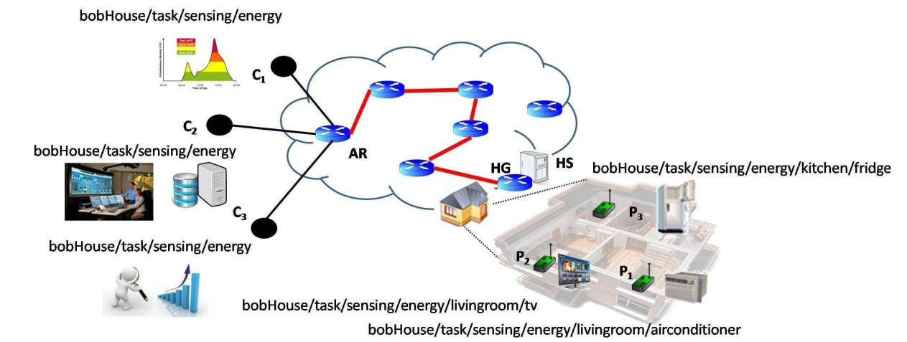
In order to better illustrate the behavior and benefits of our ICN-based framework, we provide following scenario:
We consider the reference use case shown below for an initial performance comparison between NDOMUS and potential alternatives in terms of number of exchanged packets.
Fig .Reference smart home scenario with several consumers and producers [3].

Slide 43
A number of C remote consumers request home energy consumption data for different purposes. Upon receiving the requests from the remote consumers, the HS queries all P metering devices embedded into home appliances and sends back a packet conveying the collected data. In the considered example, C=3, P =3 and N=5. The resulting number of exchanged packets is:
NCoAP = 2C + 2CN + (1 + P).
NNDOMUS= 2C + 2N + 1 + P

Slide 44
ADVANTAGES OF ICN FRAMEWORK
Improves network performance while reducing operating costs.
Eliminates many security problems.
Provides a seamless, ubiquitous experience.
Empowers the user.
Reduces congestion and latency.

Slide 45
CONCLUSION
The Smart-Condo project aims to support people with chronic conditions to live independently at home, longer.
Our approach has emphasized a privacy-respecting and nonintrusive monitoring infrastructure comprised of sensors, which collect an occupant’s activity data, and actuators, which control home ambience with the goal of improving the occupant’s living quality.

Slide 46
FUTURE SCOPE
The concept of Smart Homes has a very wide future scope.
It is an ever increasing concept and can keep growing with the growth of technology.
This is just the beginning because there will be apps created to interact with your future home robots to tell them to put food in the oven, clothes in the laundry, feed the cat and clean the bathroom.
From your smart phone (or headphone as pictured) you’ll be able to check the supplies in your refrigerator or pantry and order more from the grocery store.
Or you’ll use future home automation so that you don’t have to worry about this on a day by day basis as your pre-programmed smart home technology will take care of this for you and you can override it at will by using your phone application.

Slide 47
REFERENCES
[1] An IoT-based User-centric Ecosystem for Heterogeneous Smart Home Environments Luca Mainetti, Vincenzo Mighali, Luigi Patrono Dept. of Innovation Engineering University of Salento Lecce,ITALY
[2] The Smart-Condo: Optimizing Sensor Placement for Indoor Localization Iuliia Vlasenko, Ioanis Nikolaidis, Member, IEEE, and Eleni Stroulia, IEEE TRANSACTIONS ON SYSTEMS, MAN, AND CYBERNETICS: SYSTEMS, VOL. 45, NO. 3, MARCH 2015
[3] Information Centric Networking in IoT scenarios: the Case of a Smart Home Marica Amadeo, Claudia Campolo, Antonio Iera, Antonella Molinaro
[4] Cognitive Machine-to-Machine Communications for Internet-of-Things: A Protocol Stack Perspective Adnan Aijaz, Member, IEEE, and A. Hamid Aghvami, IEEE INTERNET OF THINGS JOURNAL, VOL. 2, NO. 2, APRIL 2015
[5] EasyConnect: A Management System for IoT Devices and Its Applications for Interactive Design and Art Yi-Bing Lin, Fellow, IEEE, Yun-Wei Lin, Chang-Yen Chih, Tzu-Yi Li, Chia-Chun Tai, Yung-Ching Wang, Fuchun Joseph Lin, Hsien-Chung Kuo, Chih-Chieh Huang, and Su-Chu Hsu, IEEE INTERNET OF THINGS JOURNAL, VOL. 2, NO. 6, DECEMBER 2015

